Slide 1


Store Sales Dataset Analysis
By Group 3 (Data witchers):
Ahmed Mohammed Sayed
Aya Mohamed Farouk
Inas Azmy Abdelhamid
Lina Samir Shalaby
Samah Ezzat Ahmed
Tools Used In Project: Python, My SQL , Tableau

Slide 2


Store Sales Dataset Analysis outline:
Sales Analysis
Customer Behavior Analysis
Timeline Analysis
Geographic Analysis
Shipping Analysis
Recommendations

Slide 3
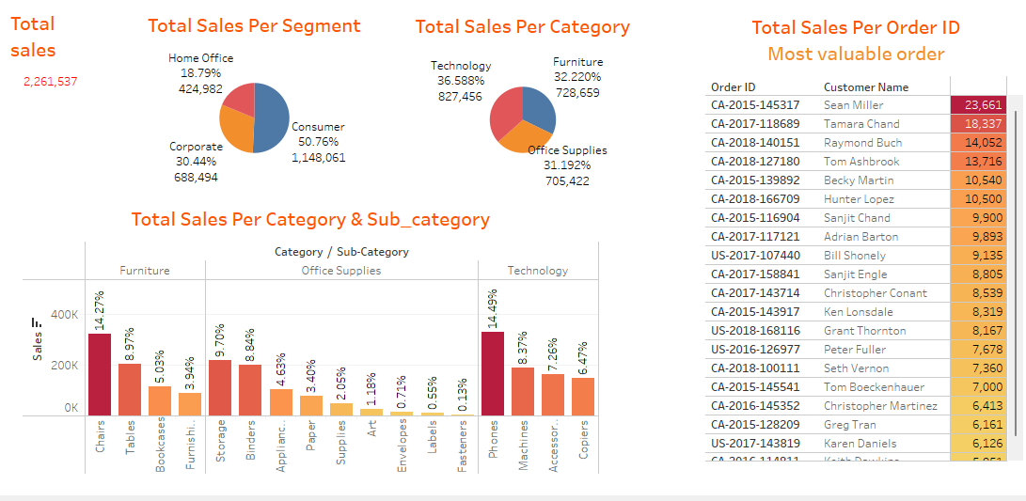

Overall Total Sales: $2,261,537
Sales by Segment: The most profitable segments are Consumer, Corporate & Home Office
Insight:
- Focus marketing & retention efforts at the Consumer segment to maintain & grow this core customer base
- Increase number of orders on the other segments
1. Sales Analysis :

Slide 4
Sales by Category: Technology is the highest-performing category, followed by Office Supplies
Opportunity: Couple Technology's superior performance with bundle offers or targeted upselling campaigns.
1. Sales Analysis :

Slide 5
Breakdown by Category & Sub-category
- Technology’s Sub-category: Phones & Accessories are high-revenue
Recommendation: Have promotions or price changes in position to fortify these underperforming sub-groups
1. Sales Analysis :

Slide 6
Sales Per Order ID:
- Sean Miller's order (CA-2015-143317) as the single largest sale of $23,561
Use Case: Customers for VIP loyalty programs or targeted upselling campaigns
Average Order Value (AOV) Analysis: Despite overall sales growth, the AOV trend is declining, suggesting a need for improved bundling or upselling.
1. Sales Analysis :
Notes:
Sales Per Order ID: A heatmap identifies Sean Miller's order (CA-2015-143317) as the single largest sale of $23,561.
Use Case: Utilize this data to identify the most suitable customers for VIP loyalty programs or targeted upselling campaigns.
Average Order Value (AOV) Analysis: Despite overall sales growth, the AOV trend is declining, suggesting a need for improved bundling or upselling.

Slide 7
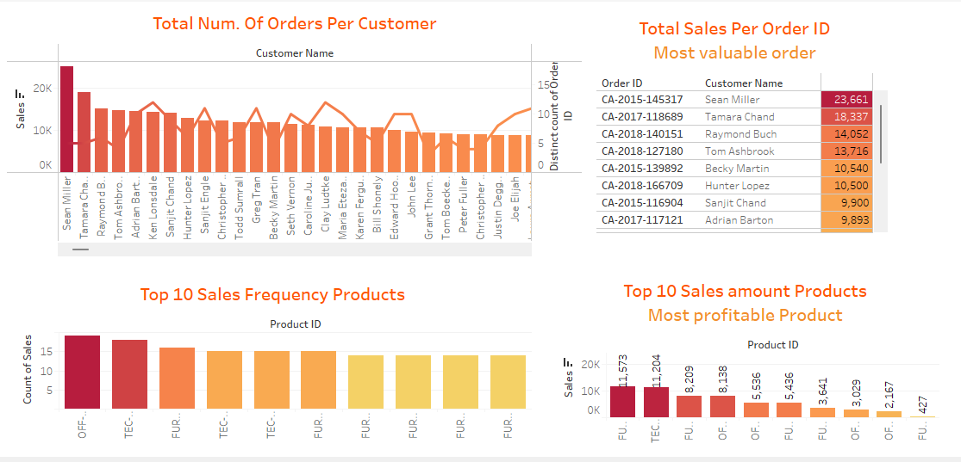

2. Customer Behavior Analysis:
Total Orders per Customer:
Top customers: Sean Miller, Raymond Buch & Tamara Chand
There is also a long tail of low-frequency buyers who offer a potential re-engagement campaign opportunity
Insight: Implement loyalty programs to keep high-frequency and high-value customers

Slide 8
2. Customer Behavior Analysis:
Sales per Order ID:
- Sean Miller's purchase is first on the list at $23,661, followed by Tamara Chand & Raymond Buch
Insight: Segment these high-spending customers for special deals or a VIP level of service

Slide 9
2. Customer Behavior Analysis:
Top 10 Most Frequently Sold Products:
Items like OFF-PA-1 (presumably Paper) & TEC-AC-1 (Tech Accessory) sell most frequently
Some Furniture products are also among the top
Insight: Stock these core products continuously & package them for greater value.

Slide 10
2. Customer Behavior Analysis:
Top 10 Most Profitable Products, Top performers are:
FUR-CH-1000024 ($11,573)
TEC-AC-10003 ($11,204)
FUR-FU-100014 ($8,209)
Insight: Market high-value products with targeted campaigns, maybe through financing or bulk pricing

Slide 11
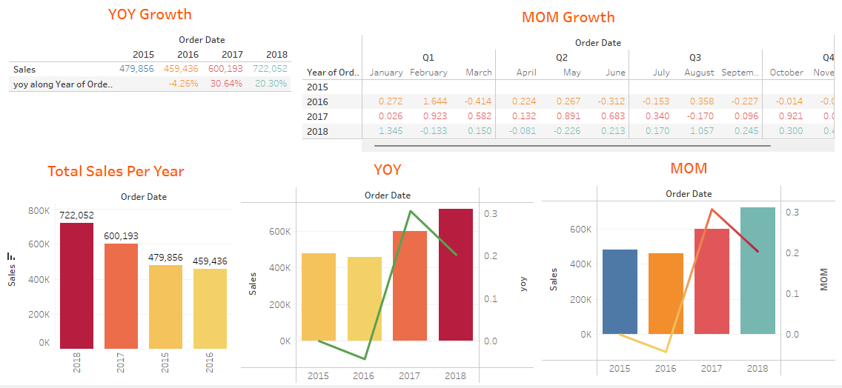
3.Timeline Analysis:
Yearly Sales Performance:
Total Sales per Year:
Sales Growth 2015 :(Sales=$479,856, No Growth)
Sales Growth 2016 :( Sales=$459,436 , Growth = -4.26%)
Sales Growth 2017 : (Sales=$600,193 , Growth = +30.64%)
Sales Growth 2018 : (Sales=$722,052 , Growth= +20.30%)
Insight:
- A slight dip in 2016 could have been due to market downturns (e.g., declining commodity prices)
- A spectacular rebound in 2017 & consistent growth in 2018 indicate good strategy implementation
- Investigate what brought about the 2017 turnaround to do it again in the future

Slide 12
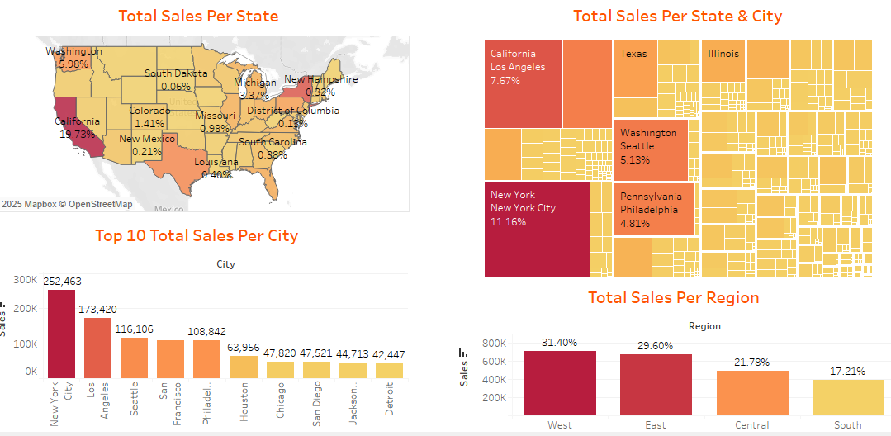
Geographic Analysis:
Sales by Region : The East region is the highest performer with 31.4%, followed by the West (29.6%). Recommendation: Maintain momentum in the East while exploring growth strategies in the Central and South regions.

Slide 13
Geographic Analysis:
Sales by State: California dominates with 19.73% of total sales. Other top performers include New York (11.16%) and Washington (5.98%). Insight: Prioritize marketing, promotions, and logistics in these high-performing states.
Top Cities:New York City leads with $252K in sales, followed by Los Angeles, Seattle, and San Francisco. Opportunity: Target these cities with customer loyalty initiatives or product expansion campaigns.

Slide 14
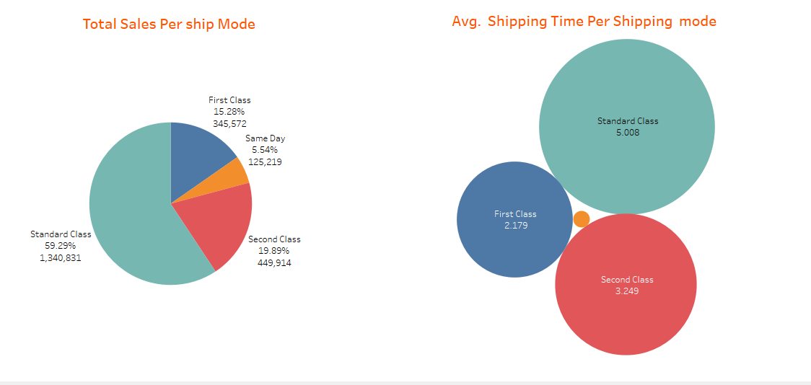
5. Shipping Analysis:
- Standard Class dominates:
The majority of shipments are via Standard Class —Likely due to its balance between cost-efficiency & delivery time
- Fast Shipping Modes Same Day:
Remained low possible room for growth if customer demand increases
- Second Class Shipping:
Shows moderate growth from 4% to 6%, stable contributor (~20% overall)
Conclusion & Recommendations
Optimize Standard Class logistics:
Since it’s the most used, improving its efficiency could significantly impact customer satisfaction and shipping costs
Promote Fast Shipping Options (First Class / Same Day):
Bundle fast shipping with premium product purchases or loyalty tiers
Test if customers are willing to pay extra for faster delivery
Continue to offer flexible shipping modes based on the product

Slide 15

6. Final Recommendation:
Customer Retention:
- Reward loyal & high-value buyers, re-engage dormant ones
Regional Focus:
- Prioritize high-performing cities and states for localized marketing
Product Strategy:
- Push high-frequency and high-value products with bundling & promotions
Shipping Optimization:
- Improve logistics & test incentives for faster delivery options
Strategic Review:
- Study what led to the 2017 rebound to inform future campaigns

Slide 16
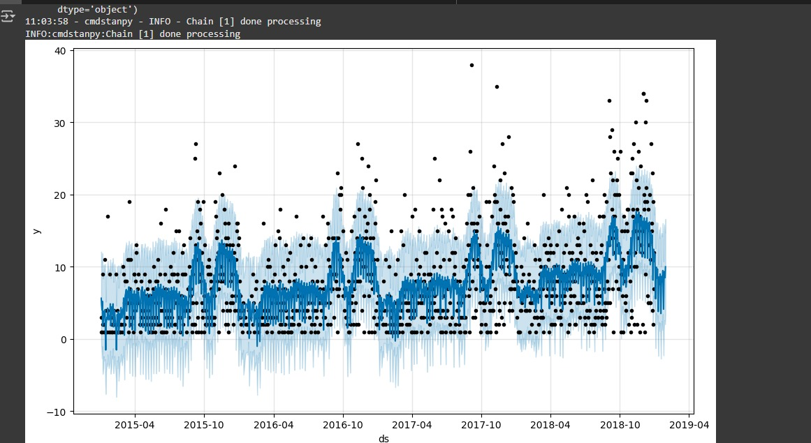
Forecasting for future sales:

Slide 17


